Slide 1
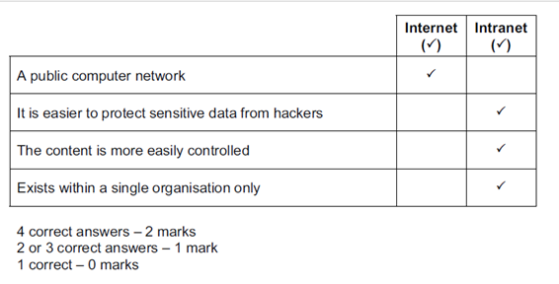
Tick whether the following statements would most appropriately apply to the internet or an intranet.

Slide 2
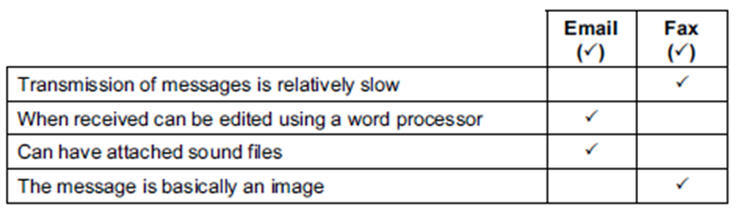
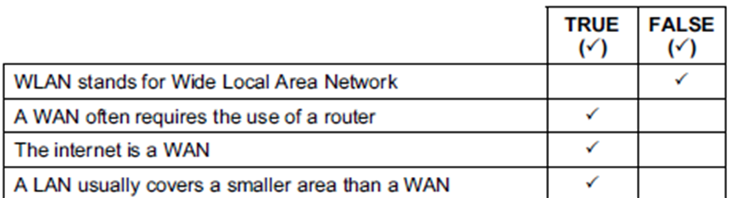
Tick whether the following are features of emails or traditional faxes.
Tick whether the following statements are true or false.

Slide 3
Use examples to describe the difference between a weak password and a strong password.
Weak password is easy to guess/strong password is difficult to guess
Weak passwords consist of all letters or all digits or all digits with one letter/all letters with one digit
Weak password is one that has few characters
Strong password uses mixture of upper case letters, digits and punctuation marks
Weak password has repeated characters
Weak password has characters next to each other on a QWERTY keyboard
Weak passwords are ones that are similar to the user name
Weak passwords are passwords that relate to the user

Slide 4
Describe how data is sent from a networked computer to a computer on a different network.
Router
The network software in the original computer determines that the destination computer is on a different network......using IP addresses
Data is sent to the switch/hub and then passed to router
the router then passes it to the router of the other network
that router passes it to the switch/hub…
…to the destination computer
Bridge
The computer sends the data to the bridge via the hub/switch…
...using MAC addresses
if the protocol/MAC address is same, bridge passes data to the other network
Bridge passes it to the switch/hub…
…to destination computer with correct MAC address

Slide 5
Describe two similarities between physical faxing and electronic faxing.
Both involve you being assigned a fax (phone) number
Both can involve use of a hard copy original
Both require the use of a phone line
Describe three differences between physical faxing and electronic faxing.
Physical faxing requires purchase of a fax machine/electronic faxing requires use/purchase of a computer/scanner
Physical faxes can be picked up by anyone/electronic faxing goes straight to your email address
Physical faxes – phone-line could be busy/engaged – electronic faxes – phone line never registers as busy/engaged
Physical faxes – must have paper and can get paper jams
Electronic fax is quicker to arrive than physical

Slide 6
Describe what an ISP is and, apart from security measures, describe what it offers its customers.
Internet Service Provider/provides Internet access
Often offers web space and domain name to create own website
Provides email address
Router to connect to the internet
Storage space to save data in the cloud
DNS service to convert URLs to IP addresses
Juanita has a computer and a contract with an ISP. When she searches the internet she does not find relevant information quickly.
Describe three ways she could reduce the amount of excess information she gets without changing either her computer or ISP.
Used advanced searches
Use Boolean operands…
…use + and – to limit results to only key words
Use speech marks around key phrases
Use the specific web address

Slide 7
Give three reasons why some companies have intranets.
It is possible to prevent employees accessing undesirable websites
They can ensure that available information is specific to their needs
It is easier to make sure confidential messages stay within the company
There is less chance of company computers being hacked
In order to make reliable information available to all students, schools often put the information on their intranet. Describe what is meant by an intranet.
An intranet is a computer network
Exists usually within one organisation/school
Meets the internal needs of an organisation/school
Can be expanded to become an extranet
Intranet is private
Intranets tend to be policed/managed
Intranet has an extra layer of security
Data found in an intranet is likely to be more relevant to the students’ needs

Slide 8
Explain, using examples, what is meant by authentication techniques.
Is a means of identifying yourself to a system
Something you know such as PIN/password
Something belonging to you such as a bank card
Something unique about you such as a biometric feature
Describe the differences in use between WiFi and Bluetooth.
WiFi technology enables local area network and Internet connections
Using WiFi, a laptop or desktop computer can connect to a network's wireless router
Bluetooth connects two devices together
Usually Bluetooth peripherals are powered by batteries that need to be charged or replaced
WiFi covers a larger distance than Bluetooth
WiFi requires more than ten times more bandwidth than Bluetooth

Slide 9
Fiona wants to communicate with her friend Myfanwy using her mobile phone.
Describe four ways she could do this.
Phone call
Text message
Email
Social network site
Blog/microblog
Video call

Slide 10
Most data protection acts include the principle that data should be stored securely.
List four other principles of a typical data protection act.
Information must be processed fairly and lawfully
Information collected must be processed for limited purposes
Information collected must be adequate, relevant and not excessive
Information collected must be accurate and up to date
Information must not be held for longer than is necessary
Information must be processed in accordance with the individual’s rights
Information should not be transferred outside the area of the Act unless adequate levels of protection exist.

Slide 11
Describe the details of computer addresses that are stored by a router.
Stores IP addresses
IP address is a unique identifier set up by network manager/ISP
Can change but should match the network it’s on
IP address consists of 4 numbers separated by full stops
Stores MAC addresses
6 pairs of hexadecimal digits
MAC address is usually hard coded by manufacturer, never changes

Slide 12
Internet banking can be used by bank customers to check their account balance.
Many ways of logging into such a system involve the use of passwords.
Describe three methods of minimising the possibility of passwords being misused if intercepted.
Encrypting the password
Ask for memorable information, such as mother's maiden name
Changing passwords very regularly
Use TANs
Only being asked for or providing a limited number of characters from the password
Twin factor authentication

Slide 13
Discuss the effectiveness of different methods which could be used to prevent unauthorised access to a laptop computer.
Examples of reliability of methods
User id and Password will prevent users who do not know the password from gaining access …will reject users who try to guess passwords (usually after 3 attempts)
Strong passwords using a mixture of alphabetic, alphanumeric and special characters …will be difficult to guess
Biometrics are unique and are almost impossible to duplicate
Using biometrics means that passwords don’t have to be remembered
Laptops can now come with fingerprint scanner and retina identification
Examples of lack of reliability
Strong passwords can be difficult to remember …can be easily forgotten and disclosed to any user
Software for retina scan can malfunction
User can have fingerprints affected by injury/cut on a finger
Laptops with this technology tend to cost more
Low cost fingerprint technology tends to be inaccurate
Fingerprints can be copied by expert thieves

Slide 14
A school’s Science department has a network which uses WiFi. A teacher has a laptop computer and whilst in school wishes to connect to this network.
Write down the name of this type of network. A WLAN
In order to access the network the laptop must be within range of a type of WiFi network device.
(i) Write down the name of this type of device.
A (Wireless) Access Point/wireless node
(ii) Describe how this device is connected to the network using an ethernet cable.
It is connected to a switch/hub
WiFi networks can be limited in their range. Describe one other disadvantage of a WiFi network compared to a cabled network.
Can get interference from another radio signal/speed of data transmission can be slower
Other valid answers like physical obstacles/walls

Slide 15
Explain what is meant by VOIP.
Voice over Internet Protocol
A set of rules that enable people to use the Internet to make telephone calls/talk each other
Sends voice data in packets using IP
Name two items of computer hardware that are needed in order to make a VOIP phone call from one computer to another.
Microphone
Speakers/headphones
Headset
A piece of programming code which maliciously deletes files is called a (computer) virus.
The scrambling of data to make it unreadable by unauthorised users is called encryption.

